Slide 1
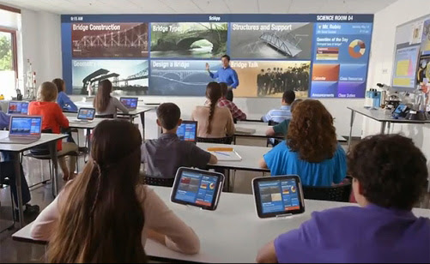
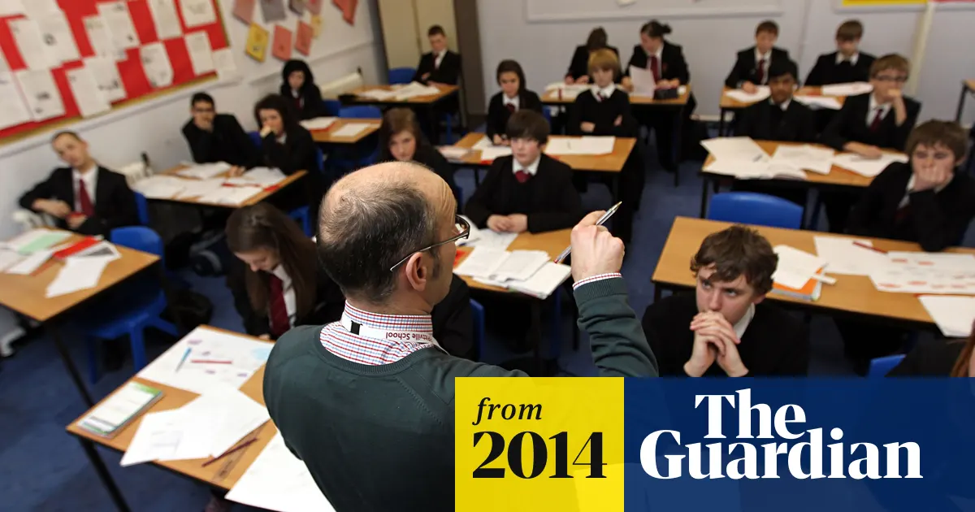
.
Traditional education
Modern Education

Slide 2

Group 2
Anusha
Sravan
Sourav
Avinash
Aarti
Satya
Hrithik
Sravan
Sandeep

Slide 3
Education is the imparting and acquiring of knowledge through teaching and learning, especially at a school or similar institution. The earliest educational processes involved sharing information about gathering food and providing shelter; making weapons and other tools; learning language; and acquiring the values, behavior, and religious rites or practices of a given culture. Before the invention of reading and writing, people lived in an environment in which they struggled to survive against natural forces, animals, and other humans. To survive, preliterate people developed skills that grew into cultural and educational patterns.
Education developed from the human struggle for survival and enlightenment. It may be formal or informal. Informal education refers to the general social process by which human beings acquire the knowledge and skills needed to function in their culture. Formal education refers to the process by which teachers instruct students in courses of study within institutions.

Slide 4
Let’s just see the major difference between the modern education and
traditional education my fellow members will help us to distinguish
between them

Slide 5
Both the types of education have their own place and importance. We cannot declare any type of education good or bad. The traditional was good in its period and the modern education is good in its period. Actually, it depends on the person. It depends on what the person wants to learn. If a person wants to learn about his customs and religion, then definitely traditional education is better for him. On the other hand, if a person wants to learn about science or mathematics, then modern education is good for him. Both the type of the educations is equally important.

Slide 6


